Slide 1
Chapter 19 Presentation
Team Lanai: Sarai Camargo, Richard Deleon, Amanda Homeyer, Niraj Bhakta, McKay Wilkerson

Slide 2
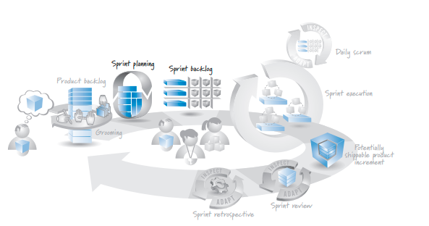

Slide 3
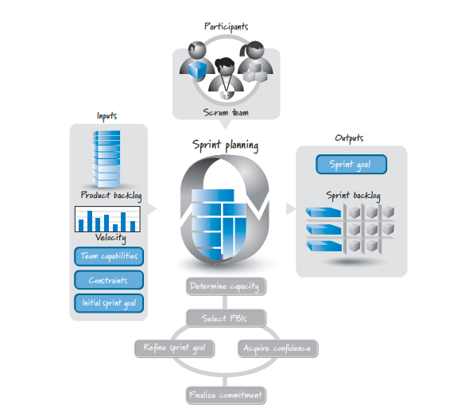

Slide 4
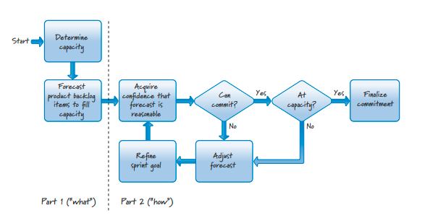

Slide 5
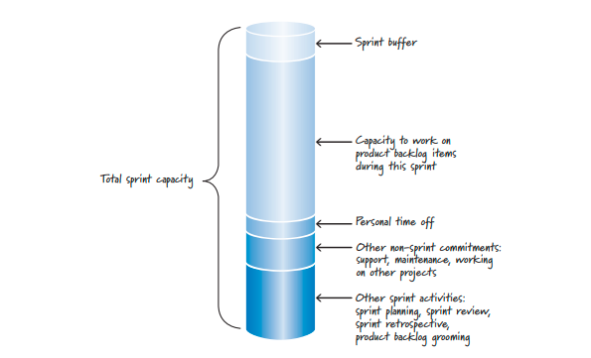

Slide 6
